Slide 1
Assigning Administrative Roles
Instructor Materials
Networking Security v1.0
Notes:
Networking Security (NETSEC)
Module 5: Assigning Administrative Roles

Slide 2
Module 5: Assigning Administrative Roles
Networking Security v1.0
(NETSEC)
Notes:
Networking Security (NETSEC)
Module 5: Assigning Administrative Roles

Slide 3
Module Objectives
Module Title: Assigning Administrative Roles
Module Objective: Configure command authorization using privilege levels and role-based CLI.
Topic Title | Topic Objective
Configure Privilege Levels | Use the correct commands to configure administrative privilege levels to control command availability.
Configure Role-Based CLI | Use the correct commands to configure role-based CLI access to control command availability.
Notes:
<number>
5 – Assigning Administrative Roles
5.0.2 – What will I learn in this module?

Slide 4
5.1 Configure Privilege Levels
Notes:
5: Assigning Administrative Roles
5.1: Configure Privilege Levels

Slide 5
Configure Privilege Levels
Limiting Command Availability
Cisco IOS software can provide infrastructure access using privilege level or role-based CLI.
By default, the Cisco IOS software CLI has two levels of access to commands.
User EXEC mode (privilege level 1), and Privileged EXEC mode (privilege level 15).
There are 16 privilege levels in total.
To assign commands to a custom privilege level, use the privilege mode {level level | reset} command global configuration mode command.
Command | Description
mode | Specifies the configuration mode. Use the privilege ? command to see a complete list of router configuration modes available on your router.
level | (Optional) Enables setting a privilege level with a specified command.
level | (Optional) The privilege level that is associated with a command. You can specify up to 16 privilege levels, using numbers 0 to 15.
reset | (Optional) Resets the privilege level of a command.
command | (Optional) Argument to use when you want to reset the privilege level.
Notes:
5: Assigning Administrative Roles
5.1: Configure Privilege Levels
5.1.1: Limiting Command Availability

Slide 6
Configure Privilege Levels
Configuring and Assigning Privilege Levels
To configure a privilege level with specific commands, use the privilege exec level level [command] global configuration command.
There are two methods for assigning passwords to the different privilege levels:
To assign a privilege level to a specific user, use the username name privilege level secret password global configuration mode command.
To assign a privilege level to a specific EXEC mode, use the enable secret level level password global configuration mode command.
Router(config)# privilege mode {level level | reset} command
Router(config)# username name privilege level secret password
Router(config)# enable secret level level password
Notes:
5: Assigning Administrative Roles
5.1: Configure Privilege Levels
5.1.2: Configuring and Assigning Privilege Levels

Slide 7
Configure Privilege Levels
Limitations of Privilege Levels
The use of privilege levels has its limitations:
There is no access control to specific interfaces, ports, logical interfaces, and slots on a router.
Commands available at lower privilege levels are always executable at higher levels.
Commands specifically set at a higher privilege level are not available for lower privileged users.
Assigning a command with multiple keywords allows access to all commands that use those keywords. For example, allowing access to show ip route allows the user access to all show and show ip commands.
Notes:
5: Assigning Administrative Roles
5.1: Configure Privilege Levels
5.1.3: Limitations of Privilege Levels
5.1.4: Syntax Checker - Configure Privilege Levels on R2

Slide 8
5.2 Configure Role-Based CLI
Notes:
5: Assigning Administrative Roles
5.2: Configure Role-Based CLI

Slide 9
Configure Role-Based CLI
Role-Based CLI Access
The Cisco IOS Release 12.3(11)T feature provides finer, more granular access by controlling which commands are available to specific roles.
Role-based CLI access enables the network administrator to create different views of router configurations for different users.
Role-based CLI access enables the network administrator to create different views of router configurations for different users.
Each view defines the CLI commands that each user can access.
It addresses security, availability, and operational efficiency.
Notes:
5: Assigning Administrative Roles
5.2: Configure Role-Based CLI
5.2.1: Role-Based CLI Access

Slide 10
Configure Role-Based CLI
Role-Based Views
Role-based CLI provides three types of views that dictate which commands are available:
Root View -To configure any view for the system, the administrator must be in root view.
CLI View - A specific set of commands can be bundled into a CLI view.
Superview - A superview consists of one or more CLI views.
Superviews have several specific characteristics:
A single CLI view can be shared within multiple superviews.
Commands cannot be configured for a superview. An administrator must add commands to the CLI view and add that CLI view to the superview.
Users who are logged into a superview can access all the commands that are configured for any of the CLI views that are part of the superview.
Each superview has a password that is used to switch between superviews or from a CLI view to a superview.
Deleting a superview does not delete the associated CLI views. The CLI views remain available to be assigned to another superview.
Notes:
5: Assigning Administrative Roles
5.2: Configure Role-Based CLI
5.2.2: Role-Based Views

Slide 11
Configure Role-Based CLI
Configure Role-Based Views
There are five steps to create and manage a specific view.
Step 1. Enable AAA with the aaa new-model global configuration mode command. Exit and enter the root view with the enable view command.
Step 2. Create a view using the parser view view-name global configuration mode command. This enables the view configuration mode.
Router# aaa new-model
Router# enable [view [view-name]]
Router(config)# parser view view-name
Notes:
5: Assigning Administrative Roles
5.2: Configure Role-Based CLI
5.2.3: Configure Role-Based Views

Slide 12
Configure Role-Based CLI
Configure Role-Based Views (Cont.)
Step 3. Assign a secret password to the view using the secret password view configuration mode command.
Step 4. Assign commands to the selected view using the commands parser-mode command in view configuration mode.
Router(config-view)# secret password
Router(config-view)# commands parser-mode {include | include-exclusive | exclude} [all] [interface interface-name | command]
Step 5. Exit view configuration mode by typing the exit command.
Notes:
5: Assigning Administrative Roles
5.2: Configure Role-Based CLI
5.2.3: Configure Role-Based Views

Slide 13
Configure Role-Based CLI
Configure Role-Based Views (Cont.)
Below is a list of commands and the description.
Commands | Description
commands | Adds commands or interfaces to a view.
parser-mode | The mode in which the specified command exists; for example, EXEC mode.
include | Adds a command or an interface to the view and allows the same command or interface to be added to other views.
include-exclusive | Adds a command or an interface to the view and excludes the same command or interface from being added to all other views.
exclude | Excludes a command or an interface from the view.
All | A "wildcard" that allows every command in a specified configuration mode that begins with the same keyword or every subinterface for a specified interface to be part of the view.
interface interface-name | Interface that is added to the view.
command | Command that is added to the view.
Notes:
5: Assigning Administrative Roles
5.2: Configure Role-Based CLI
5.2.3: Configure Role-Based Views
5.2.4: Syntax Checker - Configure Views on R2

Slide 14
Configure Role-Based CLI
Lab – Configure Administrative Roles
In this lab, you will complete the following objectives:
Part 1: Configure basic device settings.
Part 2: Configure administrative roles.
Notes:
5: Assigning Administrative Roles
5.2: Configure Role-Based CLI
5.2.5 Lab- Configure Administrative Roles

Slide 15
Configure Role-Based CLI
Configure Role-Based CLI Superviews
The steps to configure a superview are essentially the same as configuring a CLI view, except that the view view-name command is used to assign commands to the superview.
Step 1. Create a view using the parser view view-name superview command and enter superview configuration mode.
Step 2. Assign a secret password to the view using the secret password command. This sets a password to protect access to the superview.
Router(config)# parser view view-name superview
Router(config-view)# secret password
Notes:
5: Assigning Administrative Roles
5.2: Configure Role-Based CLI
5.2.6: Configure Role-Based CLI Superviews

Slide 16
Configure Role-Based CLI
Configure Role-Based CLI Superviews (Cont.)
Step 3. Assign an existing view using the view view-name command in view configuration mode. This adds a CLI view to superview.
Step 4. Exit superview configuration mode by typing the exit command.
Router(config-view)# view view-name
Notes:
5: Assigning Administrative Roles
5.2: Configure Role-Based CLI
5.2.6: Configure Role-Based CLI Superviews
5.2.7: Syntax Checker - Configure Superviews on R2

Slide 17
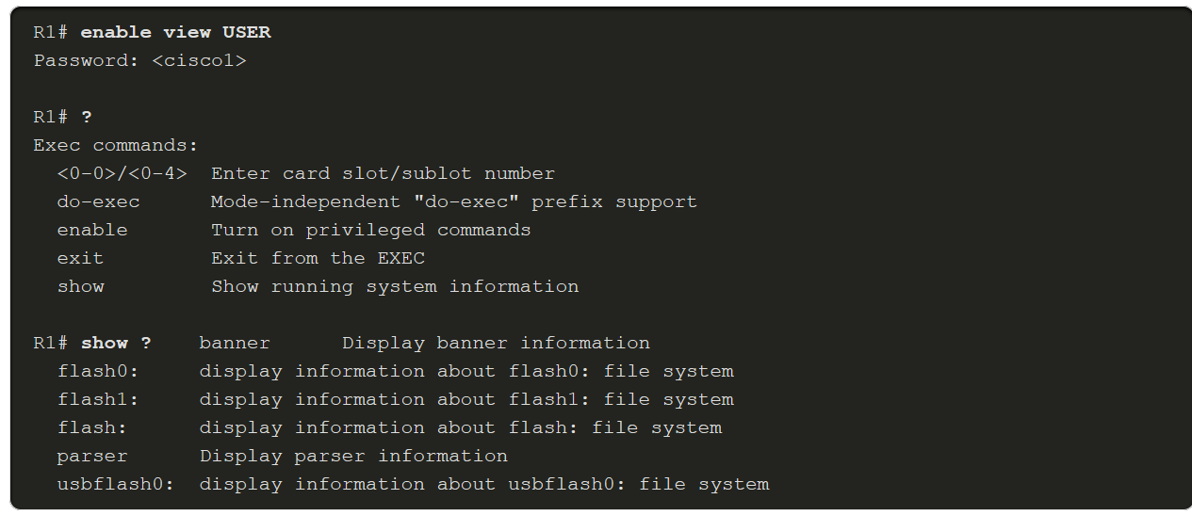
Configure Role-Based CLI
Verify Role-Based CLI Views
To verify a view, use the enable view view-name command. Enter the name of the view to verify and provide the password to log into the view. Use the question mark (?) command to verify that the commands available in the view are correct. The example enables the USER superview and lists the commands available in the view.
Notes:
5: Assigning Administrative Roles
5.2: Configure Role-Based CLI
5.2.8: Verify Role-Based CLI Views

Slide 18
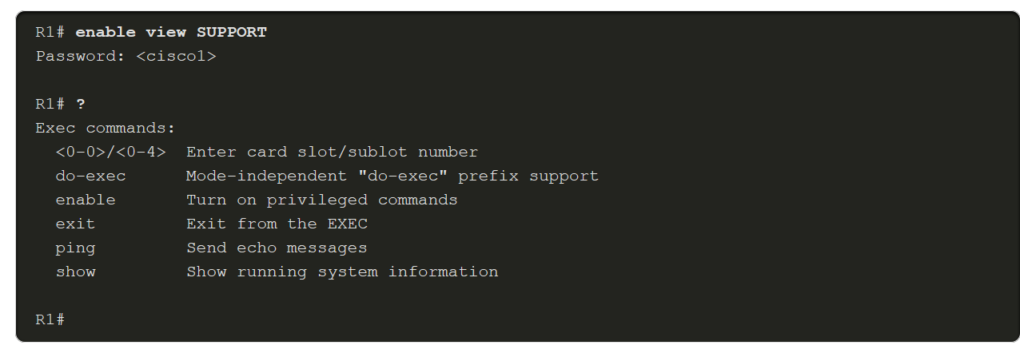
Configure Role-Based CLI
Verify Role-Based CLI Views (Cont.)
The example below enables the SUPPORT superview and lists the commands available in the view.
Notes:
5: Assigning Administrative Roles
5.2: Configure Role-Based CLI
5.2.8: Verify Role-Based CLI Views

Slide 19
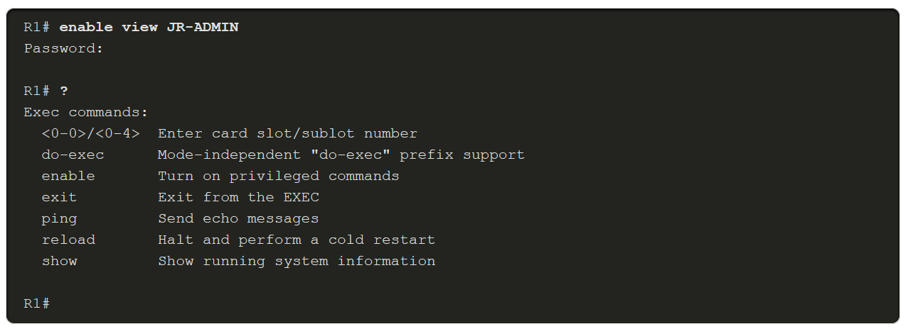
Configure Role-Based CLI
Verify Role-Based CLI Views (Cont.)
This example enables the JR-ADMIN view and lists the commands available in the view.
By not specifying a view for the enable view command, you can log in as root. From the root view, use the show parser view all command to see a summary of all views.
Notes:
5: Assigning Administrative Roles
5.2: Configure Role-Based CLI
5.2.8: Verify Role-Based CLI Views

Slide 20
5.3 Assign Administrative Roles Summary
Notes:
5: Assigning Administrative Roles
5.3: Assign Administrative Roles Summary

Slide 21
Assign Administrative Roles Summary
What Did I Learn in this Module?
IOS software supports two infrastructure access methods: privilege level and role-based CLI.
By default, there is User EXEC mode (privilege level 1) and Privileged EXEC mode (level 15).
The higher the privilege level, the more router access a user has.
To assign a command to a privilege level, use the privilege exec level level [command].
Use the username command to assign a privilege level to a specific user or use the enable secret command to assign a privilege level to a specific EXEC mode password.
Privilege levels has limitations therefore use the Cisco role-based CLI access feature.
Notes:
5: Assigning Administrative Roles
5.3: Assign Administrative Roles Summary
5.3.1: What Did I Learn in this Module?
5.3.2: Module Quiz – Assign Administrative Rolls

Slide 22
Assign Administrative Roles Summary
What Did I Learn in this Module?
Role-based CLI creates different views of router configurations for different users.
Role-based Root view has level 15 privileges but can configure or modify views.
Views can contain the same commands and there is no command hierarchy.
To create a view, AAA must be enabled using the aaa new-model command.
To enter root view, use the enable view root command and the enable secret password.
Create a view using the parser view view-name global config mode command.
Assign the view a password using the secret password command.
Assign commands to the view using the commands parser-mode command.
A superview allows a network administrator to combine multiple views together.
Add views to a superview using the view view-name command.
Notes:
5: Assigning Administrative Roles
5.3: Assign Administrative Roles Summary
5.3.1: What Did I Learn in this Module?
5.3.2: Module Quiz – Assign Administrative Rolls

